Slide 1
Home Automation Design
http://fiverr.com/paulware/help-with-your-arduino-project

Slide 2
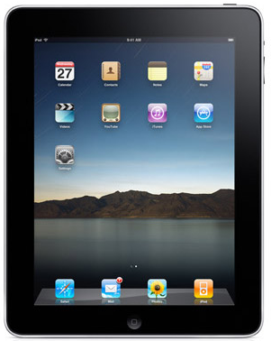
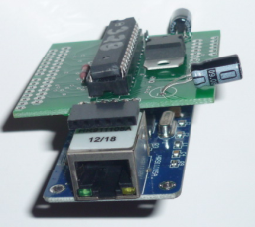
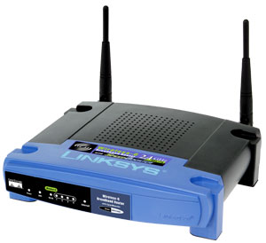
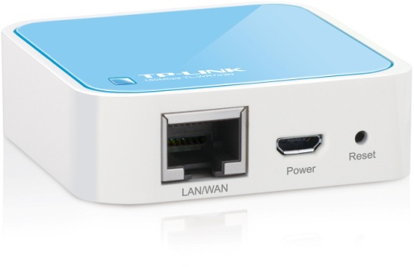
Overview
Ipad/laptop/notebook control
ENC28J60 web-server connected to wireless router
ENC28J60 web-client connected to TP-LINK 702n router repeater
Mobile Device

Slide 3
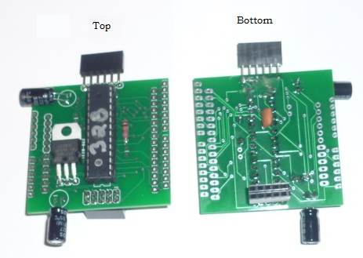
Printed Circuit Board

Slide 4
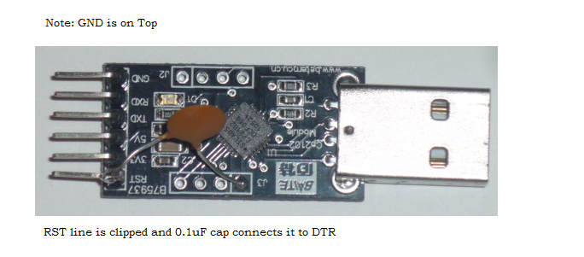
CP2102 Usb to Serial Converter

Slide 5
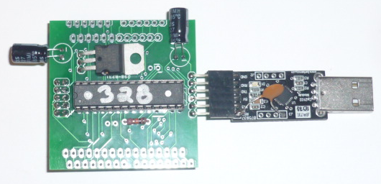
Ready for Programming
Select 328 in Arduino IDE Tools, Board

Slide 6
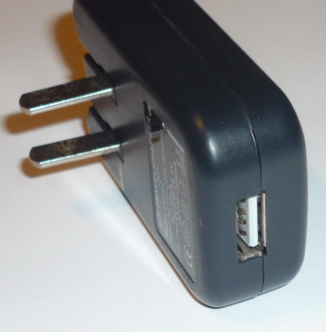
5 volt usb power supply
Available from ebay for $3.00

Slide 7
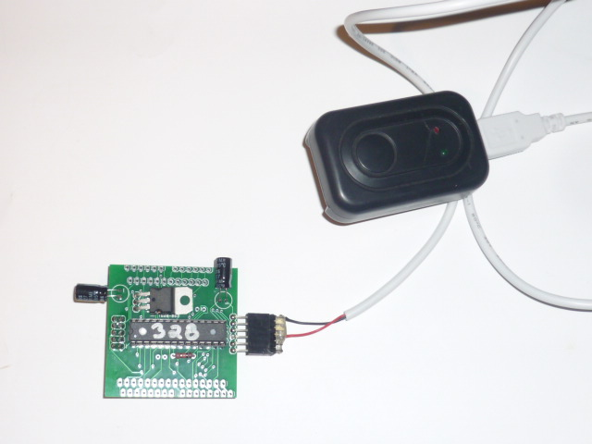
Connect to power supply
Note
GND

Slide 8
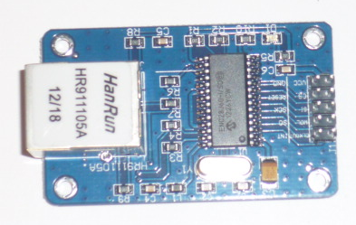
ENC28J60
Available on ebay for less than $5.00 with free shipping

Slide 9

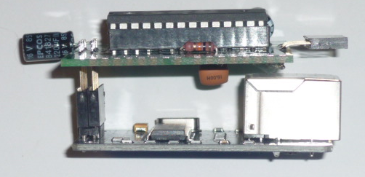
Connected to ENC28J60
Web-server and web-clients appear identical

Slide 10
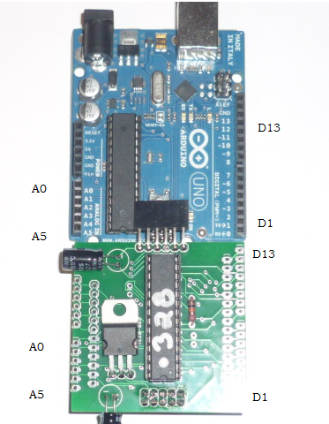
Pinout of pcb
Same as an Arduino

Slide 11
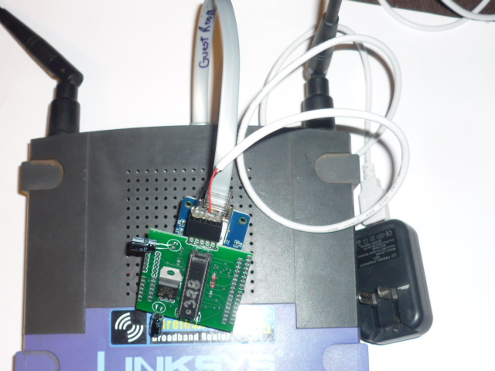
Router setup
Web-server is connected here. Sketch should be modified to reflect router address

Slide 12
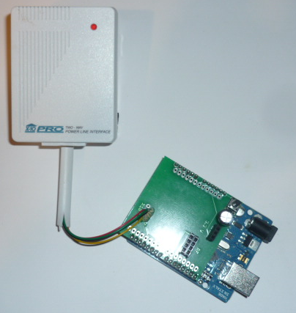
X10 Control
Arduino can turn X10 devices on or off.

Slide 13
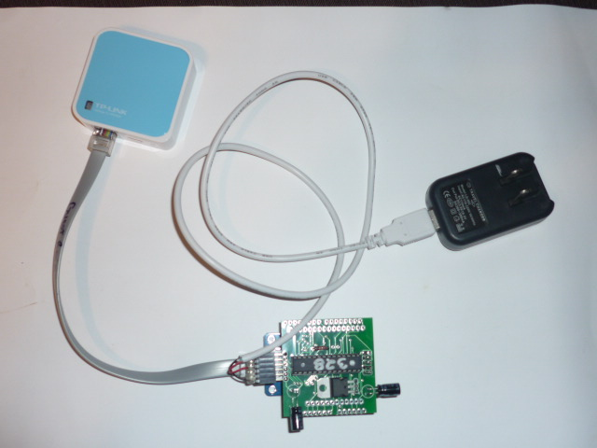
Mobile Device
TP-Link 702n Router Repeater
Give Wifi capability to moble device controlled by Arduino-PCB

Slide 14
Will move client/server code to github if requested http://fiverr.com/paulware/help-with-your-arduino-project

